Slide 1
Lekaa Suhail
Six Word Memoirs

Slide 2
Six Word Memoirs
Six Word Memoirs is a project that provides a platform to people to tell their stories in all their form.
This slideshow presentation will address important information about the Six Word Memoirs Program and Website such as origination, who started it, when was it started, history of the program and its purpose
This slideshow will also present 4 six-word memoirs from friends and family, including a detailed explanation of each memoir
From each of the recorded memoirs, I will give my input and analysis to describe how the six-word memoirs helped me to understand the people I interviewed.

Slide 3
History of the Six-Word Memoirs
The Six-Word Memoirs is a project that was started by Larry Smith who is the founder of SMITH Magazine, a U.S. based online story telling magazine.
The Six-Word Memoirs was started in 2006 when Smith asked members of his community to describe their personal lives in exactly six words.
Since then, Six-Word Memoir project has grown globally and has become a bestselling book series featured in hundreds of media outlets such as NPR and The New Yorker.
The purpose of the Six-Word Memoir project is to inspire conversations and provide a simple way for people to break the ice.

Slide 4
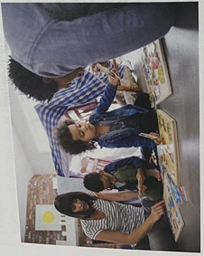
Claire (cousin), “Communication is two-way, give and take”
According to Claire, communication is an essential tool in creating strong friendship and family bond.
Both parties involved in a conversation should seek to understand the other as much as they need to give their input or opinions.
I learnt from her that strong family bonds can be created by deliberately engaging in creative communications.
In chapter 10, page 305 of our textbook, conversation-oriented families enjoy sharing family narratives.
By so doing, their family bonds are strengthened.

Slide 5

Derrick (friend), “Friendship is expensive, guard it well”
Derrick values friendships, and he loves and knows how to keep them.
He advocates for complementary personalities which result in rich and satisfying friendships/relationships
During our conversation, I got to learn that one needs to guard the friendships they make, because initiating them in the first place is an expensive affair.
Friendships come with trust and vulnerability
Relationships thrive well where involved parties have complementary characteristics (Chapter 9, page 262. Textbook)

Slide 6
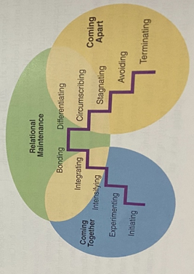
Terry (mother), “I you don’t value it, leave”
This is her lifeline and she uses it every time she is giving us advise on life issues and friendships.
When I asked her what she means by her statement, she said that she values the importance of initiating long-lasting relationships with friends and family.
Her goal is help us learn to make meaningful friendships rather than convenience friendships.
Since initiating is the relationships is the opening stage of all relationships, it is crucial to take note of one’s interest in the relationship (Chapter 9, page 267. Textbook).
Stages of relationship development

Slide 7

Maryann (friend and schoolmate), “I am passionate and easy going”
When I engaged Maryann about her statement, she said that her passion is making friends and socializing.
Well, I can confirm this as she easily makes friends and she is an interesting person to be with.
She loves to make good memories with friends.
Now I see why I have grown fond of her over time; she is intriguing.
Friendships are about sharing joys and sorrows, sharing laughs and memories, maintaining confidences and lending listening ears (Chapter 10, page 294. Textbook).

Slide 8
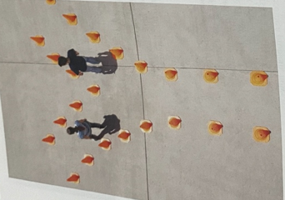
Name (me), “Not all the glitters is gold”
In communication and relationships, finding the purpose for each relationship is important as this will determine how long such a relationship will last.
Purpose in relationships beats glamour and outward appearance.
Not all relationships last for long
Some relationships may need to be terminated, and maintaining goodwill in such a case is important (Chapter 9, page 272. Textbook).

Slide 9
Conclusion
Six-word memoir is an interesting way of creating conversations and telling stories.
From my interviews and follow-up conversations, I came to realize how deep conversations can go from just six words.
From these conversations I got to learn my interviewees’ perspectives about relationships and communication.
My own six-word memoir tells of a greater meaning of relationships and communication than just being superficial; and this is purpose.

